Slide 1
Health and Illness Practices of Ultra Marathon Runners
By
Chelsea L. Giles
HSC 210: Cultural Aspects of Health

Slide 2
Learning Objectives
Learn the history of ultra marathon running
Understand what drives an ultra marathon runner to run ultra marathon distances
Learn the health and training practices of ultra marathon runners

Slide 3
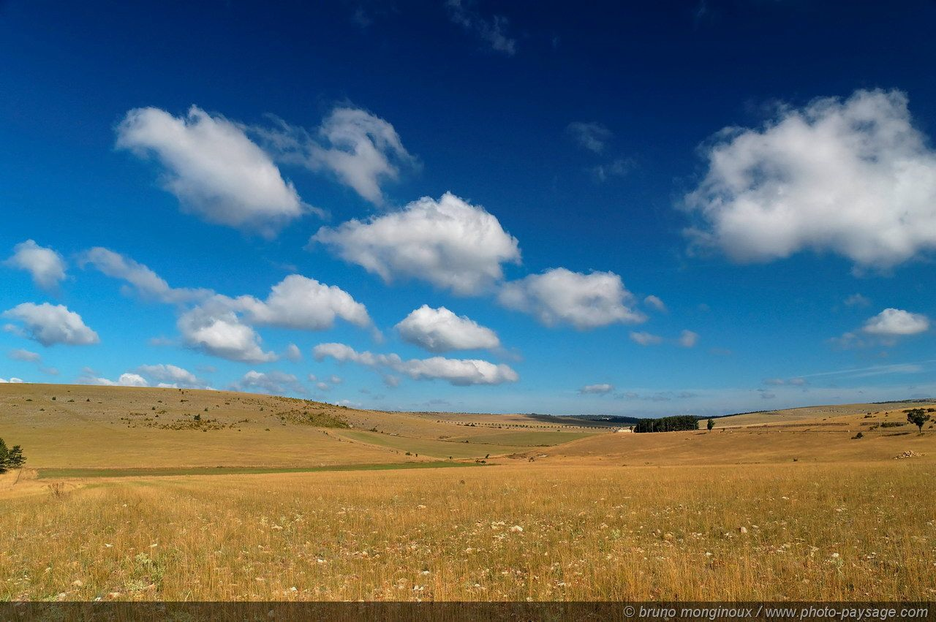
History and Background of Ultra Marathon Running
Ultra marathon running (UMR) began with migration routes between Alaska and the Great Plains.
The original ultra marathon runners were Native Americans.
Men and women could be a tribe runner.
Native Americans could run up to 400 miles continuously!
The primary purpose of running was as a means of communication.
Tribal leaders required the runners to relay information between tribes.
Runners would deliver documents to other tribal leaders.
Runners would warn other tribes of enemy attacks.
Notes:
II. McDougall P. Born to Run: A Hidden Tribe, Superathletes, and the Greatest Race the World Has Never Seen. New York, NY: Alfred A Knopf; 2009

Slide 4
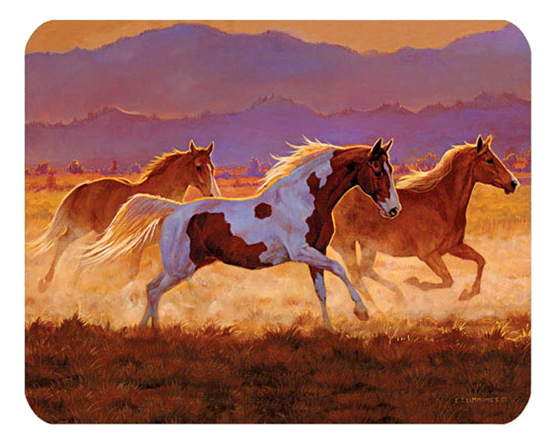
History and Background of Ultra Marathon Running
Early European settlers adapted Native American running practices
European settlers introduced the use of the horse and buggy to transport goods and deliver large quantities of goods.
For long distant deliveries runners were still preferred because the horse would collapse but the runners could keep going.
European settlers introduced automobiles.
Automobiles were the downfall of ultra running
Today ultra marathon has transformed from a necessary means of communication into a hobby!
Ultra marathon- any foot race over 26.2 miles
Notes:
I. Milroy A. In the Beginning: Native Americans. Ultra Running Magazine Website.
http://ww.ultrarunning.com/features/destinations/in-the-beginning-native-americans/
Published August 15,2013. Accessed February 4, 2015.
II. McDougall P. Born to Run: A Hidden Tribe, Superathletes, and the Greatest Race the World Has Never Seen. New York, NY: Alfred A Knopf; 2009

Slide 5
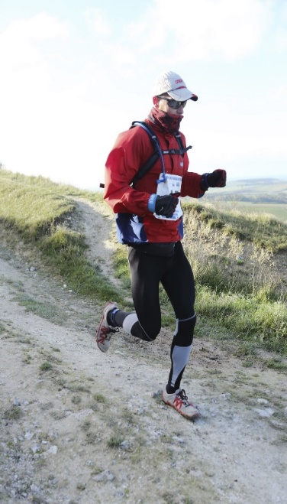
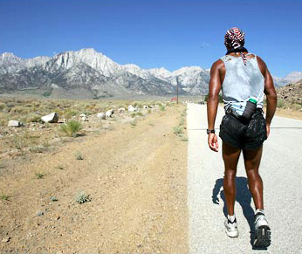
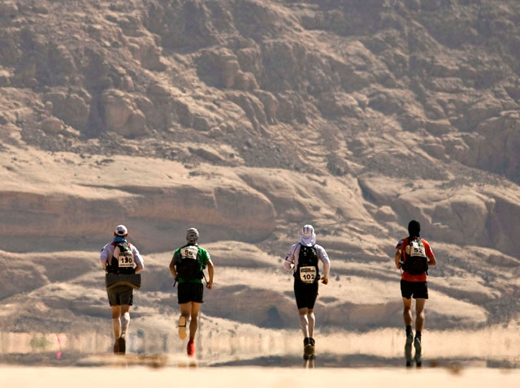
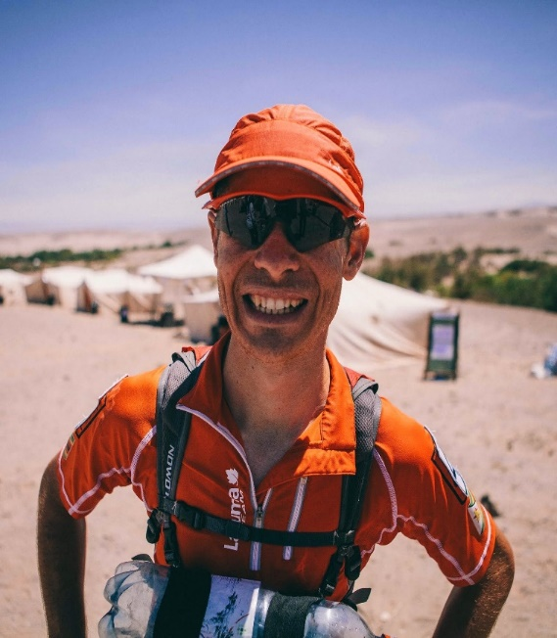
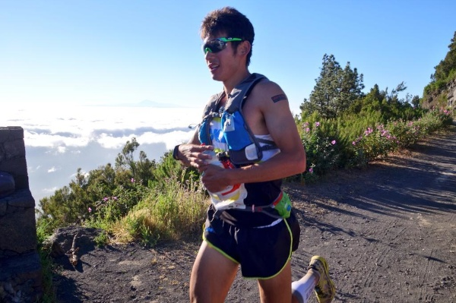
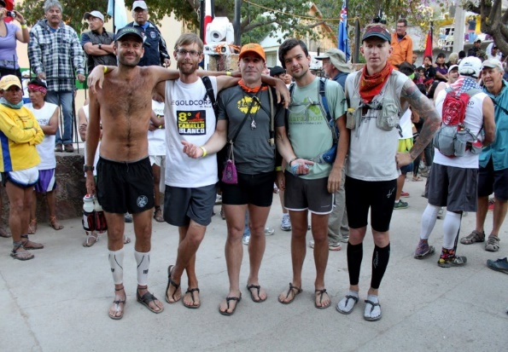
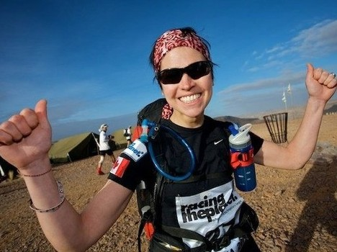
Meet REAL ULTRA RUNNERS
Notes:
X. Bing Images. http://www.bing.com/images. Accessed Febrauary 15,2015.

Slide 6
Say Hello to Steve!
Steve was born November 8, 1980 in Las Vegas, Nevada. The city scape was all that Steve ever knew, as the son of owners of a Las Vegas motel. His parents did not have a lot of time to spend with him, so he occupied his time playing alone with the toys his parents bought him. Steve did not have any friends and was constantly made fun of for being overweight. Steve grew up to be tall and lanky, not overweight anymore but unfit. He blended in with the other people along the Las Vegas strip and nothing set him apart from the masses. Working as a single business man for 10 years, Steve wanted to already be operating his own casino. However, the harder he worked the further his goals appeared to be from him. Frustrated with his work and overwhelmed by the pressures of life, Steve needed to escape!
Steve wanted something more that set him apart from everyone else in Las Vegas, something that made him different, something greater. So he turned to ultra marathon running!
Notes:
III. Jurek S. Eat and Run: My Unlikely Journey to Ultramarathon Greatness. New York, NY: Houghton Mifflin Harcourt Publishing Company;2012.

Slide 7
Ultra Runner’s Definition of Health
Health- one’s ability to push their body to the fullest extent without limitations by the mind, body, or spirit.
A runner considers themselves healthy as long as they can run.
Mental clarity is a key factor in an ultra runner’s health.
“Runner’s High”- a euphoric state when an ultra runner is able to push their body to the fullest extent by sheer mental determination, while simultaneously having a completely clear mind.
Notes:
Ultra runner Amy explains that her life does not revolve around running, running is her life. Every choice she makes is to insure that she can have the best run she can.
2. Scott Jurek also discusses the importance of his mental state of mind while running. He attributes his ability to win ultra races of 50,100,135, and 150 miles to his mental stamina. As an ultra runner you need to first believe you can win and long after your body is screaming for you to stop your mind tells you to keep going!(Eat and Run,p2)
III. Jurek S. Eat and Run: My Unlikely Journey to Ultramarathon Greatness. New York, NY: Houghton Mifflin Harcourt Publishing Company;2012.
VII. Beni Amy. Ultra Marathon Runner, oral communication, February 2015.

Slide 8
Ultra Runner’s Definition of Illness
Illness- anything that prevents an individual from running.
Ultra runners have a high tolerance for pain, not all pain is significant.
Notes:
III. Jurek S. Eat and Run: My Unlikely Journey to Ultramarathon Greatness. New York, NY: Houghton Mifflin Harcourt Publishing Company;2012. – pg. 5
VII. Beni Amy. Ultra Marathon Runner, oral communication, February 2015.

Slide 9
Ultra Marathon Diet
All natural plant based diet.
The diet includes:
Fruits and vegetables
Whole Grains (Gluten Free)
Nuts and Seeds
Soy, rice, almond, or coconut milk (Dairy Free)
The diet excludes:
Processed food
Food with artificial ingredients
Gluten
Dairy
Alcohol
Notes:
Each runner personalizes their diet. There is a general consensus in the ultra running community that the standard American diet of processed food, refined sugar, pesticides and artificial ingredients are to be eliminated.
Some runners will include meat, dairy, and gluten in their diet.
Amy was set to race the Jed Smith Ultra Classic in California in 2007. She was nervous for the race so she had a drink in her hotel, then a few more. She said she knew the damaging affects the alcohol would have to her body and ultimately her run but she was so nervous her anxiety got the best of her. Amy finished the race, in her worst ultra time and she never drank alcohol again. Amy stated; “The only thing harder than running an ultra marathon, is running an ultra marathon hung over.”
III. Jurek S. Eat and Run: My Unlikely Journey to Ultramarathon Greatness. New York, NY: Houghton Mifflin Harcourt Publishing Company;2012.
VII. Beni Amy. Ultra Marathon Runner, oral communication, February 2015.
IV. Magill P, Schwartz T, Breyer M. Building Your Running Body. New York, NY: The Experiment, LLC; 2014.

Slide 10
Steve’s Diet Requirements
Age: 34
Gender: Male
Height: 6’ 3”
Weight: 150 lbs
Activity level: Extremely Active/50 miles per day
Basal Metabolic Rate: 1,721 calories
Daily Calorie Needs: 6,721 calories
Daily Calories (max weight loss desired) 3,400 calories
Fluid requirements: 75 fl oz + rehydrating throughout the run
Protein requirements: 56 grams
Notes:
Basal Metabolic Rate is the minimum number of calories required by the body in order to carry out daily bodily functions
Daily calorie needs- the amount of calories needed to maintain body weight
The number of daily calories should not fall below 50% of an individuals total daily calorie needs. For example Steve needs 6,721 calories to maintain his body weight while still running 50 miles per day. If Steve consumes less than 3,360 calories (half of his daily requirement) his body will go into starvation mode, potentially breaking down his muscles and converting them into carbohydrates to use for fuel.
The best guide in regards to fluid requirements is to look at urine color. If urine is: dark yellow = dehydrated, Lemonade yellow= properly hydrated, clear = overly hydrated. Proper hydration levels are crucial for the body to optimally perform under high demands.
The average American consumes roughly 91 grams of protein per day. Ultra runners follow a guide of 56g for men and 46 grams for females. Too much protein puts stress on the kidneys. The kidneys are a vital organ for the long distant runner because they play a role in waste excretion, water level balancing, blood pressure regulation, red blood cell regulation, and acid regulation. Too much protein can also leach calcium from the bones causing them to weaken.
IX. Campbell,Lynn. Registered Dietitian, oral communication, February 2015.

Slide 11
Green Power Smoothie
Recipe:
2 bananas
1 cup of mango or pineapple chunks
4 cups of water
2 tsp spirulina powder
1 tsp miso
Blend and drink 15-45 minutes prior to run
Notes:
1. Spirulina- a blue-green algae found in salt water and fresh water. It is rich in protein, B-vitamins, and iron.
2. Miso is a thick paste made from fermented soybeans.
III. Jurek S. Eat and Run: My Unlikely Journey to Ultramarathon Greatness. New York, NY: Houghton Mifflin Harcourt Publishing Company;2012.- Pg 52

Slide 12
Training Program
Beginner Training
Begin training at 50%-70% of maximum run, while still being able to maintain a conversation
Count the number of times your right foot strikes the ground in 20 seconds, then multiple that by 3.The goal is 85-90 strides that consist of short, light, quick steps.
Foot strikes the ground at the forefoot or mid-foot.
Run 3-4 days per week, with substantial rest between each run.
Advanced Training
Run 5 out of 7 days of the week.
Preparation for a 50 mile run = minimum of 250 miles per week
Run in all types of weather.
Run on the same surface as the race you are preparing for.
Cross train on non-running days by completing high intensity interval workouts, agility workouts, plyometric, or moderate weight lifting.
Notes:
Although the ultra runners verbally state rest as an important part of staying healthy, there is not much time for it in their extensive training.
Advanced runners have built up their stamina to the point they can race back to back ultra marathons 7 weeks in a row. With each race an average of 100 miles, in addition to 250 miles in training, in a 7 week period ultra runners run 2,450 miles!
When I inquired why ultra runners do not rest more Amy responded; “We can’t, we just can’t. Going a day without running is like asking you to go a day without breathing. We can’t live without it.”
IV. Magill P, Schwartz T, Breyer M. Building Your Running Body. New York, NY: The Experiment, LLC; 2014.
VII. Beni Amy. Ultra Marathon Runner, oral communication, February 2015.

Slide 13
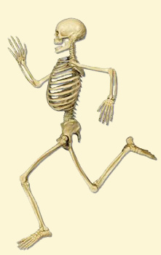
Preventative Care
Stretching before and after exercise.
Allowing a warm up period of about 15 minutes prior to exercising.
Allowing a 15 minute cool down period after exercising
Wearing the appropriate shoes and clothing
Rehydrate connective tissue
Eat a proper diet
Rest
Regularly visit a chiropractor
Notes:
Stretching is an important aspect in running. The brain will signal the muscle fibers to contract, if those muscle fibers are too tight it will result in a weak muscle contraction. Placing high demands on muscles that are too tight can result in sprains.
The warm up period prior to exercise raises the temperature of the muscles. A warmer muscle is going to contract more strongly. In addition, warm up allows for the synovial fluid found in the joints to be absorbed into the articular cartilage providing more cushion and support at the joints. This helps prevent unnecessary wear and tear on the joints.
Rehydrating the connective tissues refers to a method called MELT. In this method a runner rolls different muscles over a foam roller. The idea is that the connective tissues are being rehydrated, ultimately allowing the muscles to recover more quickly.
Chiropractors are essential for restoring the body’s proper alignment. When the body is properly aligned nerves can fire efficiently, joints can move freely, and muscles can contract maximally.
VII. Beni Amy. Ultra Marathon Runner, oral communication, February 2015.

Slide 14
Healing Practices
Rest
8 hours of sleep each night
Rehydrating connective tissue
Eating a proper diet
Visiting a Chiropractor
Visiting a physical therapist
Visiting a homeopathic doctor
Visiting a medical doctor
If in need of an x-ray or surgery
Notes:
Many ultra runners avoid the average primary care doctor for two reasons. One, they have a tendency to prescribe only medications which ultra runners are not willing to put in their body. Two, in the case of sprains and strains, medical doctors tell them to not run for 6-8 weeks. Being told not to run for 6-8 weeks is a death sentence to an ultra runner.
Chiropractors, physical therapists, and homeopathic doctors focus on naturally healing the body. They also offer therapeutic techniques and adjustments that allow the runner to heal faster and minimize the time spent not running.
VII. Beni Amy. Ultra Marathon Runner, oral communication, February 2015.
IV. Magill P, Schwartz T, Breyer M. Building Your Running Body. New York, NY: The Experiment, LLC; 2014.

Slide 15
Behaviors and Beliefs
Ultra runners can be from any race, gender, background, or religious affiliation.
It is paramount to focus on running, so many ultra runners take a vow of celibacy.
Running is not just a part of an ultra runner’s life it is who they are.
Ultra runners believe they can set themselves apart from average by running ultra marathons.
Many ultra runners are searching for a purpose in this world and they find it in their running.
Notes:
Ultra runner Scott stated “ Running is what I do. Running is what I love, Running it to a large extent who I am.” (Eat and Run, p. 2)
Ultra runner Amy echoed Ann by mentioning what a vital part of her day running is and she can not live without it. She compared the importance of running to breathing, it’s a daily requirement to live.
Amy began ultra running after a divorce from her verbally abusive husband. She was so beat down inside that she did not feel like she was worth anything. She stated that running gives her a purpose and a reason to live. Now as an ultra marathon runner she has an identity and a community of racers that have become her family. She said it also built her confidence in herself and there is now nothing she can’t do.
I. Milroy A. In the Beginning: Native Americans. Ultra Running Magazine Website.
http://ww.ultrarunning.com/features/destinations/in-the-beginning-native-americans/
Published August 15,2013. Accessed February 4, 2015.
III. Jurek S. Eat and Run: My Unlikely Journey to Ultramarathon Greatness. New York, NY: Houghton Mifflin Harcourt Publishing Company;2012.

Slide 16
Health Concerns
- Dehydration
Dehydration can lead to heat stroke and death while running.
- Sprains, muscle spasms, and torn ligaments
These may be from improper foot placement, falls, or overuse injuries
- Break down of cartilage in the joints, especially the knees
Most ultra runners require knee replacements when they get older
- Increased risk of developing arthritis
Arthritis is inflammation of the joints that make it difficult to move and sometimes impossible to move the arthritic joint.
- Hardening of the arteries, increasing the risk of a cardiovascular event
- Hypertrophy of the heart muscle
Notes:
In a new study doctors found that ultra runner’s arteries begin to stiffen. The exact cause of this is unknown. However, the hardening of the arteries decreases blood flow and results in heart attacks.
The heart is a muscle that can be enlarged. In the case of ultra runners the high demand they place on their heart day after day results in an actual increase in size of the heart muscle. The increase in size of the heart’s walls can cause the heart to beat in an abnormal rhythm that leads to death.
VIII. Simmons, Lee. Enlarged Heart and Running. LiveStrong..com
<http:www.livestrong.com/article/310153-enlarged-heart-running>
November 17, 2010. Accessed February 14, 2015
VI. Quinn E. Checklist for Running Overuse Injuries. Sports Medicine Website.
http://www.sportsmedicine.about.com/od/runninginjuries/a/runners_overuse.htm
December 15,2014. Accessed February 6,2015.

Slide 17
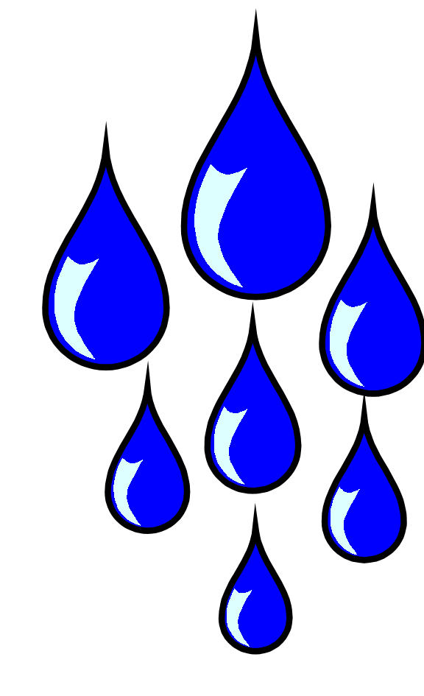
External Health Concerns
1. The elements:
Hot temperature- leads to heat exhaustion and death
Sun- second degree burns
Wind- wind burn
Rain/Ice- increased risk of falling
Freezing temperatures- leads to frostbite and amputations
2. Poisonous Plants: Poison Ivy, Poison Oak, Poison Sumac
These plants can cause debilitating blistering rashes
3. Animals:
Snakes- snake bites (some are lethal)
Spiders- spider bites (some are lethal)
Bears & mountain lions – attack and kill runners
Raccoons, Dogs, Coyotes- attack runners
Mosquitoes, bees- cause stings, allergic reactions, and diseases
Squirrels- dart out in front of runners causing missteps and injury
Alligators- attack runners, biting off lower extremities
Skunks- spray with odor that leeches into the skin and can
burn the eyes
Notes:
It makes perfect sense why ultra runner Ann stated “ Some sports take safety precautions, ultra runners take death-avoiding precautions!” (Born to Run, p. 6)
Ann’s first run was the American River 50-Mile Endurance Run. A double marathon that featured snake bites, skin eruptions, and oppressive heat from the sun.
VII. Beni Amy. Ultra Marathon Runner, oral communication, February 2015.
II. McDougall P. Born to Run: A Hidden Tribe, Superathletes, and the Greatest Race the World Has Never Seen. New York, NY: Alfred A Knopf; 2009

Slide 18
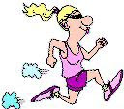
Cultural Factors
Ultra runners are trying to escape whatever culture they are a part of.
Mainly the fast paced, busy American lifestyle
Ultra running comes with a community of runners that develop into its own culture.
Ultra marathon runners are searching for a purpose in their life and without it they are the same as everyone else, they fear being average and not leaving a mark on the world
Notes:
1. Ann explained in “Born to Run” that her favorite part of running is being able to escape. She said that “ Winning had thrilled me, but what thrilled me more was forgetting my worries, losing myself.” (p.266)
2. Talk in the ultra racing community includes discussing training programs, diet, bowel movements, injury prevention techniques, and survival stories.
Although fellow race friends are also competitors in a 50,100, and150 mile race the biggest competition is yourself. It is you versus you in ultra runs.
III. Jurek S. Eat and Run: My Unlikely Journey to Ultramarathon Greatness. New York, NY: Houghton Mifflin Harcourt Publishing Company;2012.
II. McDougall P. Born to Run: A Hidden Tribe, Superathletes, and the Greatest Race the World Has Never Seen. New York, NY: Alfred A Knopf; 2009

Slide 19
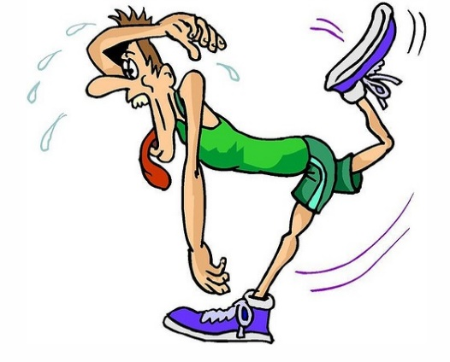
Ultra Running Statistics
1. About 0.3% of the population has completed an ultra marathon
Men’s record for the fastest 100 mile road race
Bernd Heinrich (USA)
May 19, 1984 – Ottawa Canada
Time: 12.27.01
Pace: 7 minute, 28 second mile
Women’s record for the fastest 100 mile road race
Ann Transon (USA)
May 4, 1991 – Queens, New York
Time: 13.47.41
Pace: 8 minute 16 second mile
Notes:
XI. Ultramarathon Running Resources. UltramarathonRunning.com.
http://www.ultramarathonrunning.com/recods 12/1/2014. Accesses February 15,2015.

Slide 20
Competent Care for Ultra Runners
1. Runners need access to a dietitian who specializes in marathon and ultra marathon running diets, in order to properly prepare them for training.
2. Runners need affordable access to physical therapists to maintain joint mobility and prevent injury.
3. Runners need affordable access to chiropractors to restore total body alignment.
4. Members of the healthcare team need
to understand that not running, is not an option.
Notes:
Most ultra runners turn to the internet to begin their new diet program. Many go through a process of trial and error which can be very dangerous for someone who is attempting to run a 50 mile race overhydrated, under nourished, and full of protein.
The main problem with our healthcare system is not having affordable access to natural/holistic healers. Health practitioners who promote total body alignment, nutrition, and therapeutic healing are not covered by insurance.
Physical therapy costs may be covered under the insurance AFTER the runner is injured. There is no coverage provided for preventative care.
As the healthcare system stands today, they are not competently caring for ultra runners. Their focus needs to shift to preventative care. And the words “stop running” should never come out of their mouth.
VII. Beni Amy. Ultra Marathon Runner, oral communication, February 2015
IX. Campbell,Lynn. Registered Dietitian, oral communication, February 2015.

Slide 21
Exam Questions
What qualifies a race as an ultra marathon?
50 miles B. 100 miles C. Over 26.2 miles
2. Who were the original ultra marathon runners?
A. Early European Settlers B. Native Americans C. 21st century runners
The original decline in the need for ultra runners was due to?
A. horses B. automobiles C. It was never a necessity
4. What is the main drive behind ultra marathon runners?
A. Escaping their worries and searching for purpose
B. Wanting to make an investment in their health
C. Enjoys spending time in the outdoors.
5. What is the biggest challenge ultra runners face with the healthcare system?
A. Runners are focused on preventative care, the healthcare system is not
B. The healthcare system focuses on preventative care, runners do not
C. There is not affordable access to holistic doctors and dietitians
D. Both A and C are correct
Notes:
Anwsers
1. C 2. B 3. B 4. A 5. D

Slide 22
References
I. Milroy A. In the Beginning: Native Americans. Ultra Running Magazine Website.
http://ww.ultrarunning.com/features/destinations/in-the-beginning-native-americans/
Published August 15,2013. Accessed February 4, 2015.
II. McDougall P. Born to Run: A Hidden Tribe, Superathletes, and the Greatest Race the World Has Never Seen. New York, NY: Alfred A Knopf; 2009
III. Jurek S. Eat and Run: My Unlikely Journey to Ultramarathon Greatness. New York, NY: Houghton Mifflin Harcourt Publishing Company;2012.
IV. Magill P, Schwartz T, Breyer M. Building Your Running Body. New York, NY: The Experiment, LLC; 2014.
V. Long Term Ultra Marathon Running and Arterial Compliance. US National Library of Medicine Website. http://www.publicmedicine.gov. May 17,2014. Accessed February 5, 2015.
VI. Quinn E. Checklist for Running Overuse Injuries. Sports Medicine Website. http://www.sportsmedicine.about.com/od/runninginjuries/a/runners_overuse.htm
December 15,2014. Accessed February 6,2015.
VII. Beni Amy. Ultra Marathon Runner, oral communication, February 2015.
VIII. Simmons, Lee. Enlarged Heart and Running. LiveStrong..com
<http:www.livestrong.com/article/310153-enlarged-heart-running>
November 17, 2010. Accessed February 14, 2015
IX. Campbell,Lynn. Registered Dietitian, oral communication, February 2015.
X. Bing Images. http://www.bing.com/images. Accessed Febrauary 15,2015.
XI. Ultramarathon Running Resources. UltramarathonRunning.com.
http://www.ultramarathonrunning.com/recods 12/1/2014. Accesses February 15,2015.

